Slide 1
Where is FHIR?
80+ FHIR-related quarters this week
See the complete list on the wiki:
http://wiki.hl7.org?title=FHIR_Agenda_201405_WGM
If you’re aware of others (or anything changes), please update

Slide 2
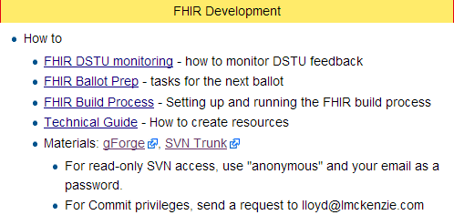
FHIR WG expectations
For next DSTU
http://wiki.hl7.org/index.php?title=FHIR

Slide 3
DSTU monitoring
Instructions for monitoring:
Ballot discussion forums
Change tracker
List server (not that you need those . . .)
Target is initial response to comments/questions in ~2 business days
Two people per WG (with responsibility for FHIR content)

Slide 4
Target for next DSTU
Upgrade existing resources (and new content) to meet QA criteria
New domain resources & profiles
Profiles CCDA entries as FHIR resources

Slide 5
FHIR DSTU timelines
PSSs for FHIR work for DSTU2
New resources, new profiles, maintenance
Draft by May 16th
Approved by May 30th
Content ready for QA Sept 21
Apply QA updates starting Oct 12
Ballot Jan cycle
Publish ~ end of March, 2015
Depends on volume of ballot comments

